Slide 1
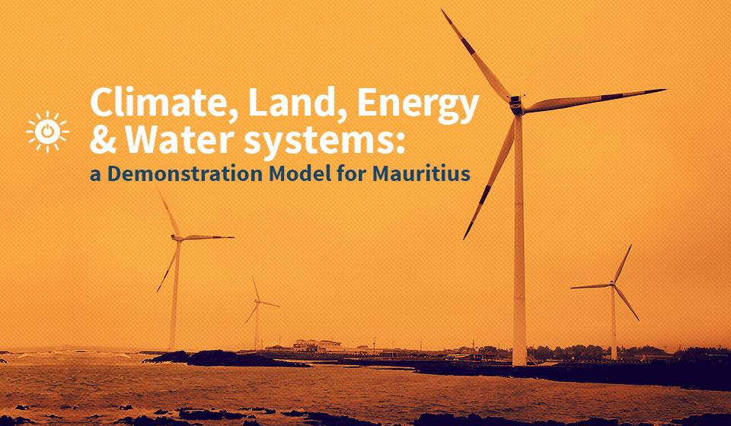

Slide 2
CLEWS Country Module
1. The food-energy-water nexus and sustainable development
2. The need for integrated planning: case studies
3. The CLEWS modelling approach
4. CLEWS case studies
5. Hands-on exercises with CLEWS

Slide 3
2. The need for integrated planning: case studies

Slide 4
Key weaknesses of sector policy design done in isolation
Policy formulation and assessments are quite often done in isolation by separate and disconnected institutional entities. This contributes to:
Lack of communication and coordination
Distrust
Incoherent, counterproductive policy formulation and decisions
High probability of inefficient use of scarce resources
Absence of an institutional structure and buy-in for integrated analyses and planning

Slide 5
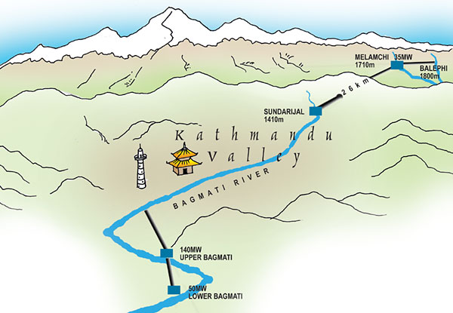
Example: Melamchi trans-basin water supply, Nepal
Plan to supply underserved consumers in Kathmandu Valley with water
Large infrastructure project
Trans-basin transfer of water
Potential for project to serve multiple uses
Irrigation
Hydropower component
Opposed by line agency
Strong resistance to expand project scope
Blocked role in project implementation by other agencies
Project went ahead as single-purpose urban water project
Notes:
The Kathmandu Valley has faced chronic water shortages for many years. Unmetered consumption is rife, as are technical losses from leaky pipes and tanks as well as severe pollution. Numerous studies from the 1980s by different donor agencies have suggested rates of leakage and water theft that are as high as 70 percent.
Diverting water from the upper reaches of the Melamchi River, a tributary of the snow-fed Sun Kosi north of Kathmandu, was identified as a viable measure to remedy the water shortage problem in the early 1970s.
The Melamchi project involves the construction of a tunnel located at an altitude of 1,700 metres on the upper reaches of the Melamchi River. It would bring water down to Sundarijal in the Kathmandu Valley at 1,400 metres, thereby creating a head of 300 metres so that about 25 MW of power could be generated. But the idea was later abandoned amid claims that it was not feasible. It is true that having to dig a 27-kilometre long tunnel just to generate about 25 MW of electricity sounds too expensive even at a cursory glance. But the fact that the tunnel had to be constructed anyway was filtered out by those pushing for a single-silo water supply project. In generating power from the same water, the incremental cost of the tunnel would have been low for the power generation component.
The principal Nepali line agency for this project is the Department of Water Supply and Sewerage of the Ministry of Housing and Physical Planning. Its mandate is water supply. There has been strong resistance to adding electricity or any other component that would involve sharing a project with other line agencies.

Slide 6
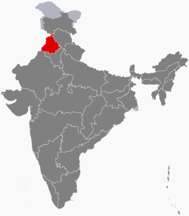
Example: Punjab, India
Punjab has only 1.5% of India’s land, but its rice and wheat production accounts for 50% of the grain the Government purchases and distributes to feed more than 400 million poor Indians.
Groundwater is being withdrawn faster than it can be replenished
No restriction on landowners’ rights to pump water on their own land
Government set prices incentivize planting of water-intensive crops
Electricity provided free to farmers
Water levels drop; increased pumping is putting additional stress on an already fragile and overtaxed electricity grid
Excessive pumping not only leads to overexploitation of aquifers, but also to high electricity demand
Irrigation accounts for about 15-20% of India’s total electricity use
Notes:
A key driver for water depletion is food demand (i.e., 1.2 billion mouths to feed).
As the law stands, landowners have the right to draw as much as they see fit from their wells. A system of government set prices encourages farmers to plant water-intensive crops such as sugarcane and rice. And state governments in India provide electricity to farms at no charge or at heavily subsidized flat rates, making the water completely free to pump in many areas (as long as the water level doesn’t drop so low that you need a new well or a pump).

Slide 7
The need for integrated planning
These issues highlight the challenges faced by governments pursuing sustainable development.
Development is a complex web of interwoven concerns and vested interests.
Decisions can have far-reaching consequences outside the targeted area, sector or jurisdiction.
Impacts can be unintended and unforeseen.
Cross-sectoral and cross-system impacts may be either positive or negative (or both).
A coordinated and integrated process to develop policies and measures with adequate attention given to cross-cutting aspects is needed.
Includes the concerns and perspectives of all affected systems/sectors.
Assesses the complementarity and conflicts among policy goals.
Stakes out a path that makes appropriate compromises (trade-offs) to pursue overall development.

